Slide 1
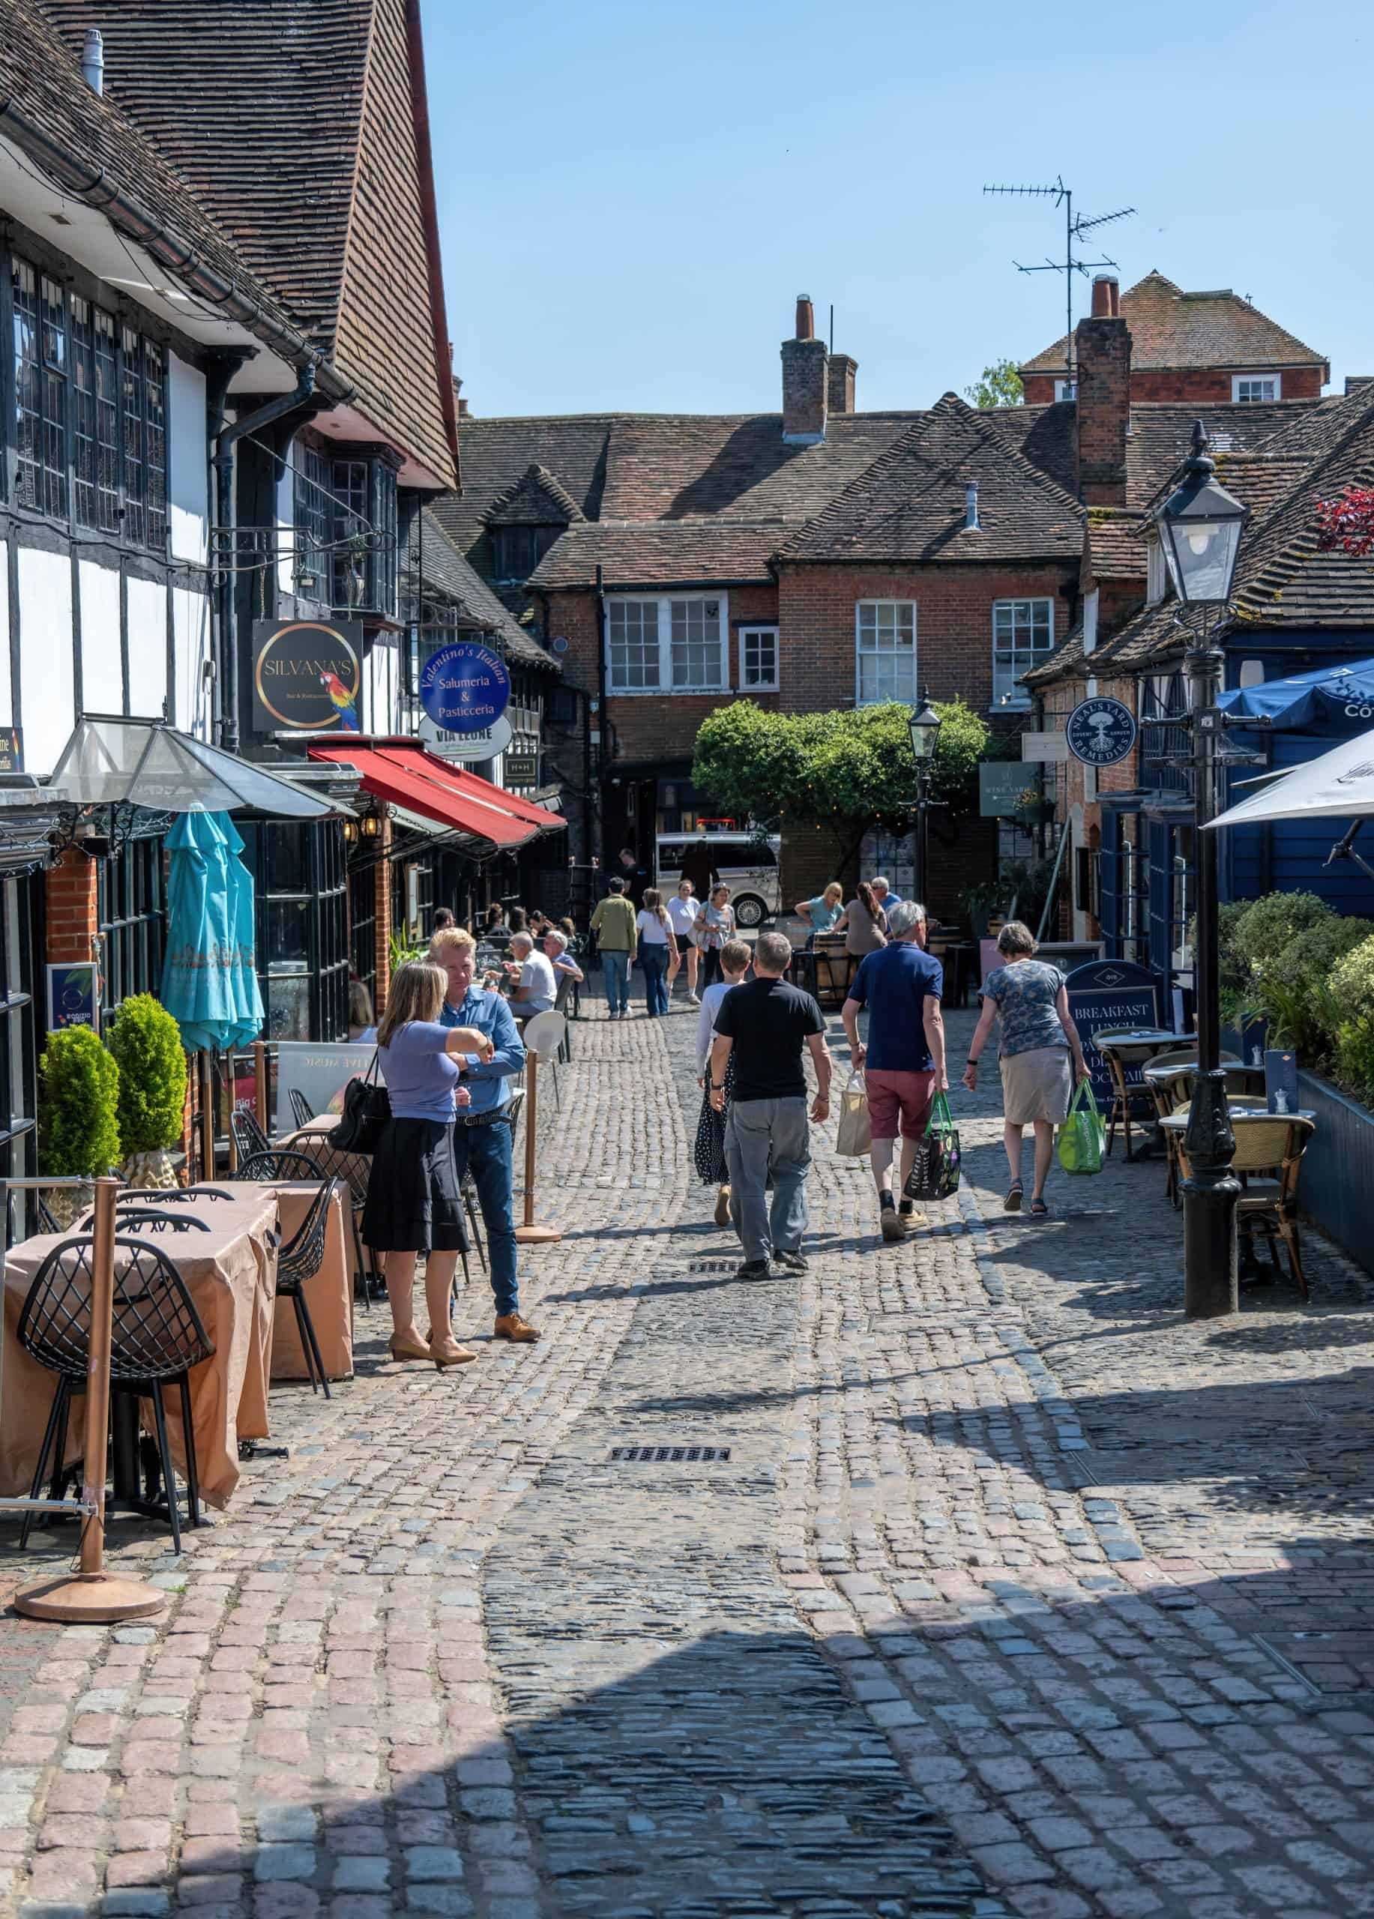
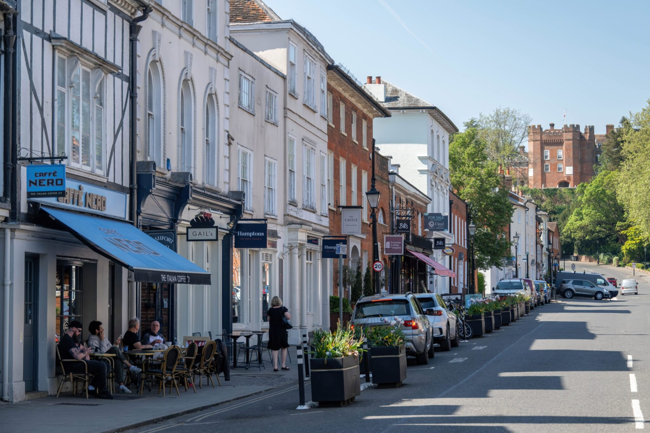


FARNHAM BID
Annual General Meeting 10th of June 2026
Supporting Businesses • Driving Footfall • Promoting Farnham •
A Year of Delivery, Investment and Impact

Slide 2
Year 2 At a Glance 2025 -2026
Over 460 Levy-paying businesses represented
£308,880
Levy income received
169
Town Ranger incidents managed
88% Reduction in shoplifting incidents from May 2025 to January 2026
New BID Team In Place

Slide 3
Key Achievements 2025/26
New BID Team Recruited
Major Marketing Campaigns Delivered
Monthly Newsletter Established
Footfall & Visitor Insights Introduced
75+ Business Engagements, Consultations & Meetings
Ongoing Representation of Business Priorities

Slide 4
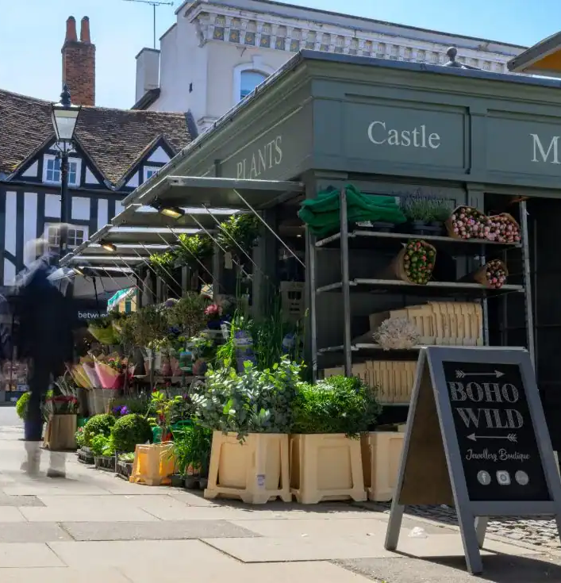
Business Survey Results
Listening to Businesses
Survey Responses 41% of Business Base
High Response Rate.
🚗 Parking remains the biggest concern
45% Neutral or Undecided on BID support
🚧 Roadworks continue to impact trade
📧 📈 Footfall and promotion remains important

Slide 5
What Businesses Told Us
Better communication needed → monthly newsletter launched
Better insight → footfall data introduced
Stronger promotion → multi-channel campaigns delivered
Key issues → parking & roadworks
Renewal Opportunity – 45% undecided (26% yes/ 25% no) The remaining 4% did not provide a definitive response

Slide 6
Farnham BID Business Community
460+ Levy-Paying Businesses
11 Business Sectors Represented
80% of Businesses Pay Under £1,000 Levy
94% of Businesses Pay Under £5,000 Levy
A Diverse base, largely made small of independent businesses

Slide 7
LEVY HOLDERS BY SECTOR
Retail 20.3%
Hospitality 12.8%
Property Services 10.4%
General Services 9.5%
Health & Medical 8.2%
Business Services 7.1%
Professional Services 6.9%
Charity & NFP 6.3%
Financial Services 6.1%
Hair & Beauty 6.3%

Slide 8
Levy Contribution By Sector
67% of levy income (£184,785) comes from non-retail, non-hospitality sectors
Retail: 20% (£86,727) includes 94 businesses, many independents
Hospitality: 13% (£43,581) includes 59 businesses, mix of independents and nationals
• 11 sectors represented

Slide 9
Levy Profile & Business Base
Businesses sit across five levy bands, with the majority in the lower bands.
Levy profile by band (percentage of total levy profile):
£0 – £500: 20.7%
£500 – £1,000: 22.3%
£1,001 – £2,000: 23.3%
£2,001 – £5,000: 17.6%
£5,001 – £20,000: 16.0%

Slide 10
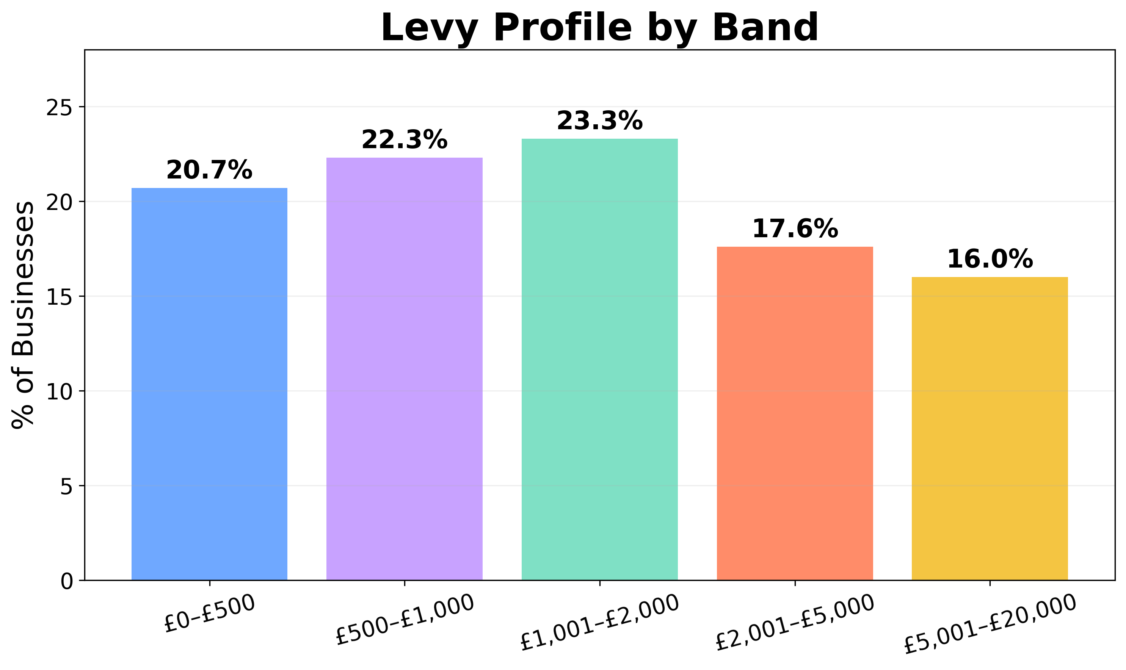
Percentage of Levy Income by Band

Slide 11
Delivering Against the BID Business Plan
The Four Pillars
1. MARKETING AND PROMOTION
Promoting Farnham, supporting businesses, increasing visitor awareness
2. TOWN SAFETY & ENVIRONMENT
Supporting a safe, welcoming, well-managed town centre
All BID activity is delivered through four strategic priorities agreed by levy payers and set out within the Farnham BID Business Plan.

Slide 12
Delivering Against the BID Business Plan
Part 2
BUSINESS SUPPORT & ENGAGEMENT
Listening to businesses, providing support, representing levy payer interests
ACCESS, TOWN TRAVEL & EXPERIENCE
Improving accessibility, visitor experience, and infrastructure
These four priorities form the basis of Farnham BID's Key Performance Indicators

Slide 13
Pillar 1 Marketing & Promotion
What We Delivered
Global radio & Christmas campaigns delivered
Social media and PR activity boosted visibility
Monthly newsletter launched
New website and business directory live
Successful partnerships and seasonal events

Slide 14
Marketing Results & Statistics
Global Radio campaign: 1.66 million targeted impressions across five months
333,334 impressions per month in Farnham and surrounding areas (How often the advert is played)
32% share of voice across target postcodes (up from 17% at Christmas)
On average, around one in every three adverts delivered within the campaign was promoting Farnham.
Equivalent of 151 days of continuous radio airtime
Increased awareness and visibility for Farnham businesses

Slide 15






Farnham On Air 🎵
Advertising across Global Radio's leading stations
Heart • Capital • Classic FM • Smooth • LBC • Gold • Radio X
1.66 million targeted impressions
Supporting awareness of Farnham as a destination

Slide 16

Global Radio Farnham Jingle
🎵 Custom Farnham jingle developed for the Global Radio campaign
📻 Featured across advertising on Heart, Capital, Smooth, Classic FM, LBC, Gold and Radio X
🎯 Designed to support awareness of Farnham as a destination
📢 Provides a consistent and recognisable message across campaign activity
🌟 Supporting the promotion of Farnham, its businesses and visitor offer

Slide 17
Social Media Results (Last 90 Days)
57,608 content views
5,625 accounts reached
1,409 content interactions 172 new followers gained
Top performing reel
Most viewed posts
Celebrating the Rangers 2.7k views
Pretty Little Farnham collaboration, 21,700 views
Xmas Installation 7.9k views Nutcracker Trail 4.1k views

Slide 18
Marketing
Impact
Increased awareness & visibility for Farnham businesses
Enhanced destination marketing for Farnham
Significant growth in audience reach and engagement
Successful partnership activity with Pretty Little Farnham

Slide 19
Place Informatics & Visitor Insights
382,785 visits recorded in April 2026
53-minute average dwell time (+32.5% year-on-year)
10% increase in visitors travelling 10–25 miles
20.1% increase in visitors travelling 25–50 miles
Visitors are spending longer in Farnham
The town is attracting people from a wider catchment area

Slide 20
Pillar 2 Town Centre Safety & Environment
What We Delivered
Town Ranger service across the BID area
Visible on-street presence supporting businesses and visitors
Partnership working with Surrey Police, local authorities, and partners
Targeted deployment in hotspot areas
169 incidents managed, 88% reduction in shoplifting
Improved confidence and reassurance for businesses

Slide 21
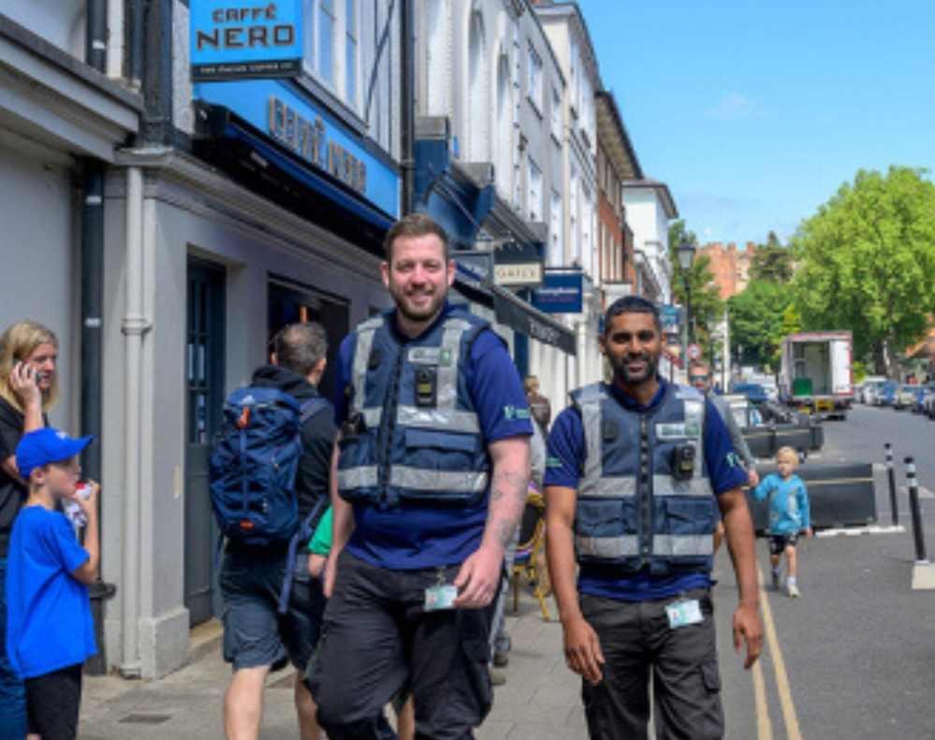
Impact & Outcome
Significant reduction in incidents across the year
Improved confidence and reassurance for businesses
Strong partnership working across the town
More proactive intelligence sharing and reporting
Enhanced support for businesses affected by crime
Incidents reduced from 34 (May 2025) to 4 (Jan 2026) 88% reduction over the year

Slide 22
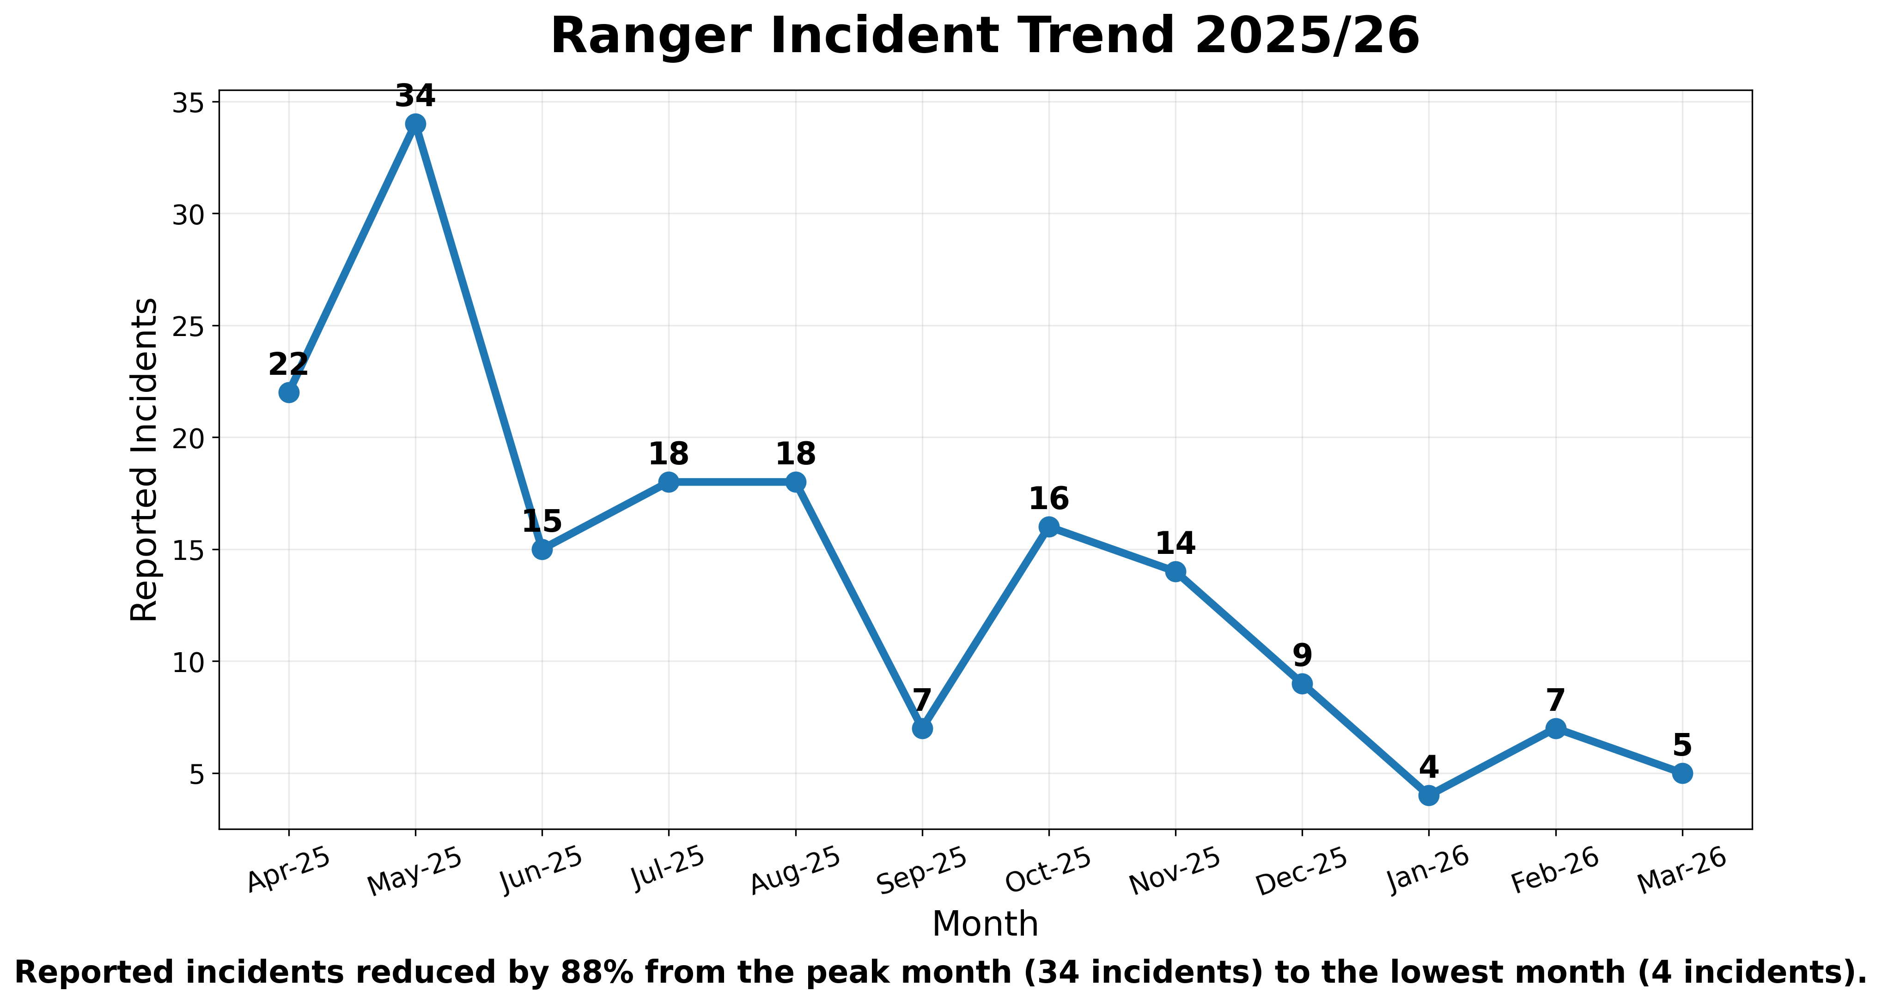
Rangers Service: Year 1 Results

Slide 23
Pillar 3 Business Support and Engagement
What We Delivered
Independent Business Survey completed across the BID area
Ongoing engagement and business visits
Presenting business concerns and priorities to stakeholders
Promotion of business support, training and funding opportunities
Advocacy on parking, roadworks and town centre issues
Newsletter launched to improve communication with levy payers

Slide 24
Newsletter & Business Communications
Launched in 2025/26 to improve communication with levy payers
Sent to 303 business contacts
Achieved a consistently high open rate
Targeted resends boosted engagement high open rate
Expanding our business contacts database to reach more businesses
Enhancing communication and engagement across the BID area

Slide 25
PILLAR 4 Access, Town Travel & Experience
Place Informatics footfall and visitor insight reporting
Promotion of Farnham as a destination
Collaborated with local organisations to improve the visitor experience.
Represented BID members’ interests during FIP
Enhanced visitor information and destination marketing
Ongoing engagement on access and town centre issues, including monthly FIP meetings.
Via the Make It Farnham website and social media editorial.

Slide 26
Parking Initiatives & Discounts
BID funded reduced parking rates and festive offers to support businesses and visitors during roadworks
Ongoing engagement on access and town centre issues, including monthly FIP meetings
Place Informatics footfall and visitor insight reporting informs our strategy

Slide 27

Delivering Farnham BID

Slide 28
How the BID Team Delivers the Business Plan
Business support & communications: business visits, newsletter, website, database, training.
Marketing & projects: destination campaigns, radio, events, project delivery
Governance & partnerships: board reporting, AGM, councils, police, ranger management
Finance & administration: budget monitoring, supplier management, levy support, compliance, Board reporting & presentations
Strong governance and financial oversight maintained
Successful transition to new BID Manager and Finance & Support Co-ordinator
Ongoing stakeholder engagement and partnership working - Councils/Police
Continued delivery against the Business Plan and improved communication

Slide 29
Current Financial Overview
Levy Income Received in 2025/2026
£308,880
Bank Balance as of June 2026
£183,300
Strong Governance Maintained
Funds retained to support committed expenditure, future projects, freelance staffing and operational reserves.
Levy Income collected over the year includes outstanding levy from 2024/2025
89k carried forward reflecting levy income received at the end of March, after most 2025/26 activity had been delivered.

Slide 30
Current Projected Spend 2026/2027
Projected Ranger Service £55,440
Current Staff NI Pension
£73,200
Allocated Marketing Costs £24,000
Software, Subscriptions & Tech £3000
External Events and Content Support £19,440
Global Radio Summer Campaign
£25,000
Christmas Lights
£12,500
Allocated Xmas Parking Support
£5,000
Place Informatics Visitor Data
£3,900
Accountancy £2500
Hosting and IT £2000

Slide 31
Looking Ahead & Building on Year 2
Continued use of Place Informatics visitor data and reporting
Ongoing website development and destination marketing
Enhanced business communications and engagement
Partnership working with councils, organisations, and town centre partners
Summer campaigns, Food festival - Taste of Farnham
Supporting a vibrant, successful and thriving Farnham town centre
Business awards, and Christmas activities planned for 2026/27

Slide 32
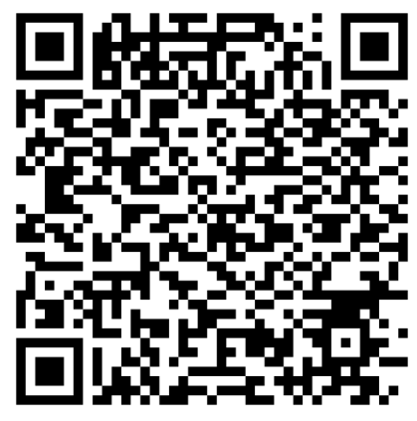
THANK YOU
Working together to support a vibrant and successful Farnham
Stay Connected
Scan the QR code to:📧 Subscribe to our newsletter
🌐 Visit the Make It Farnham website
📅 Discover events, activities and what's on
🛍️ Explore Farnham businesses
📢 Receive BID news, updates and opportunities
http://www.makeitfarnham.co.uk/
Instagram: @makeitfarnham

